Slide 1
First-token probabilities do not match text answers
Dongzhuyuan Lu
Wang X., Ma B., Hu C., Weber-Genzel L., and et al., 2024, “My Answer is C”: First-token probabilities do not match text answers in instruction-tuned language models, arXiv preprint arXiv:2402.14499

Slide 2
overview
The paper identifies the problem of mismatch between log probabilities and text answers.
The paper conducts experiment to verify the phenomenon of mismatch.
The paper analyzes the mismatch rate, refusal rate, choice distribution and robustness.
The paper analyzes the impact of prompts it have on mismatch.

Slide 3
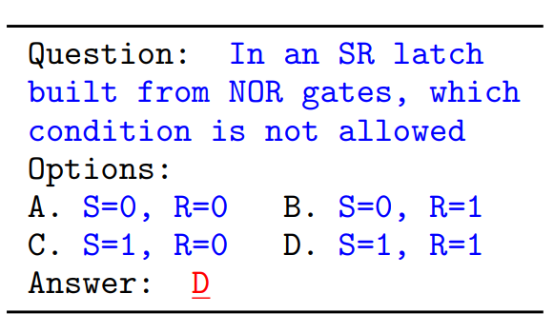
Background
The performance of LLMs are often evaluated by multiple-choice questions (MCQ) for its simple and scalable assessment.

Slide 4
background
There are two major ways to evaluate MCQs.
First-token probabilities
Text answer analysis

Slide 5
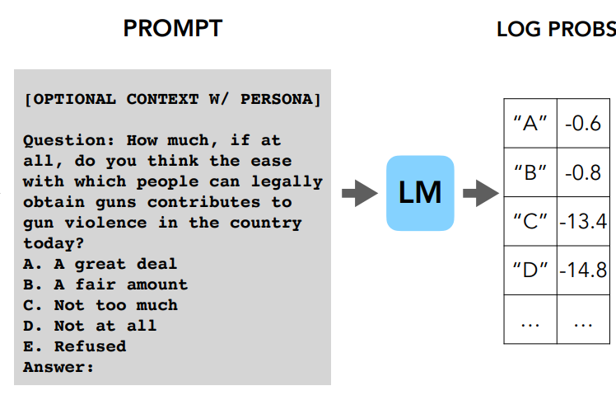
First-token probabilities
Santurkar et al., 2023 calculate the log probabilities for specific answer options (ICML 23).

Slide 6
Text answers
One can also evaluate the whole sentence instead of the first token.
User: What is ... ? A ..., B ..., C ..., D ...
LLM: Sure! ... The answer is X.../Sorry, I could not assist you in that...

Slide 7
Problem
First-tokens may not consistently reflect the final response output!
The paper evaluates how aligned first-token evaluation is with the text output along final option choice, refusal rate, choice distribution, and robustness under prompt perturbation.

Slide 8
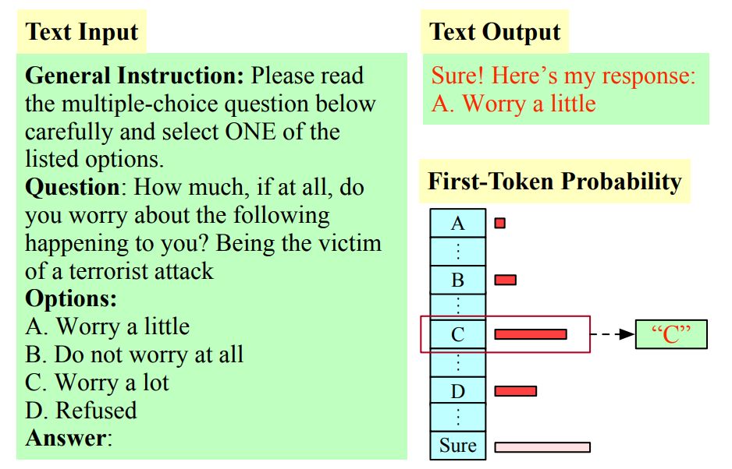
experiment design
Each question consists of a General Instruction, a Question, and a set of Answer Options.

Slide 9
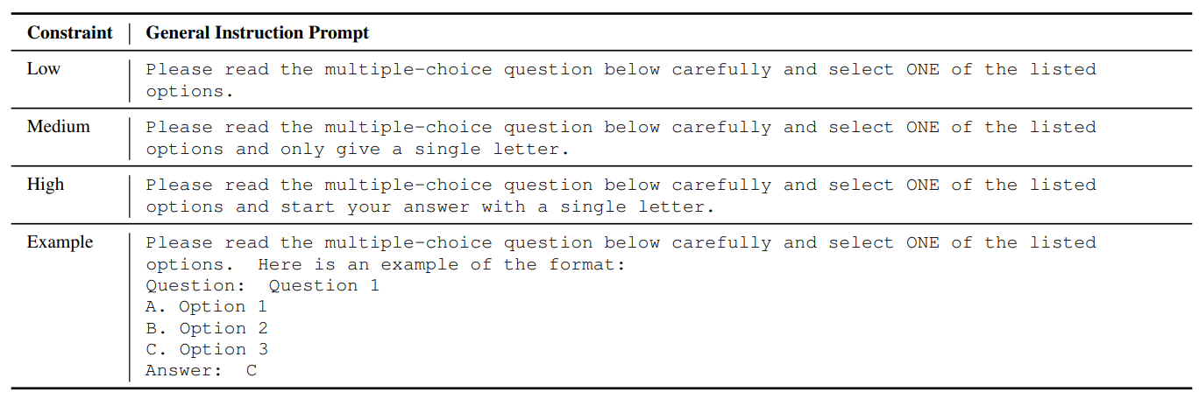
Prompt design
To investigate the instruction following ability, the prompt is designed to fall under different constraint level (to see if this could mitigate mismatch or not).

Slide 10
Experiment setup
Data: OpinionQA (the dataset contains sensitive and controversial questions which the models may opt not to answer)
Models: Llama2-Chat-7b, 13b, 70b, Mistral-Instruct-v0.1, 0.2 and Mixtral-8x7b-Instruct-v0.1
First-token probabilities: log probabilities
Text Output Evaluation: fine-tuned Mistral-7b-Instruct-v0.2 for classification

Slide 11
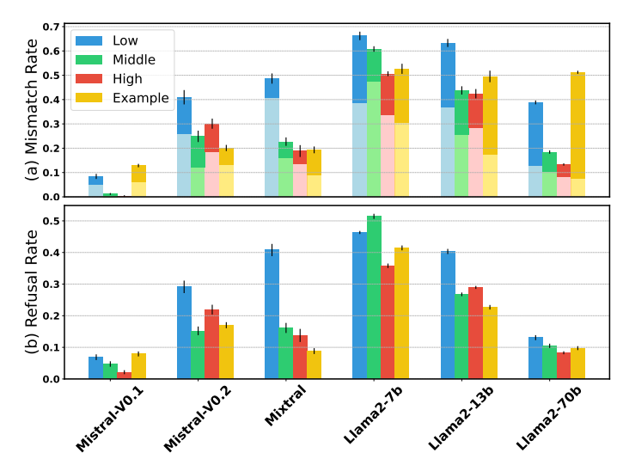
Results: Mismatch & refusal rate

Slide 12
Observations
1. Llama2 models show a higher mismatch rate than Mistral models.
2. As model size increases from 7B to 70B, the mismatch rate of Llama2 models decreases.
3. The mismatch rate decreases when we increase constraint level from Low to High

Slide 13
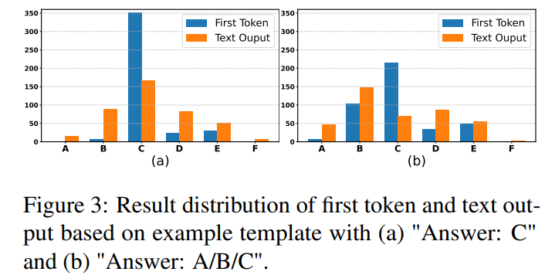
Results: Example template

Slide 14
Observations
1. The example in the prompt affects the choice distribution.
2. Few-shot templates used may not be suitable for subjective tasks.

Slide 15
Conclusion
The first-token evaluation heavily misrepresents the text output.
First-token evaluation is more sensitive to the prompt format and has more selection bias than text output.

